Slide 1


BacShield Chitosan Antimicromicrobial
Persistence Efficacy Test Results
Keun Seok Seo, DVM, MS, PhD
Associate Professor
Department of Basic Sciences
College of Veterinary Medicine
Mississippi State University

Slide 2
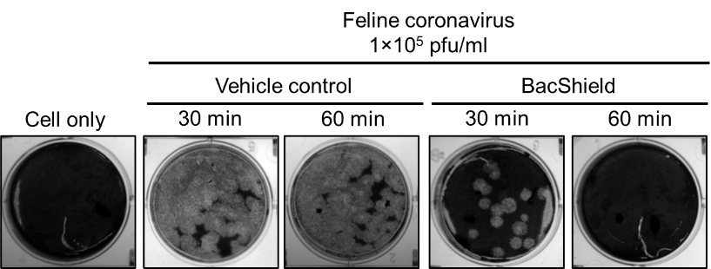
First BacShield Tests Showing Corona Destruction
A 5 second treatment with chitosan at a 30 cm distance in 30 minutes decreased feline coronavirus from 1×104 pfu to 1×101 pfu and in 60 minutes completely killed feline coronavirus, while a treatment with vehicle control (1% acetic acid) did not affect the viability of feline coronavirus.”
May 29, 2020

Slide 3
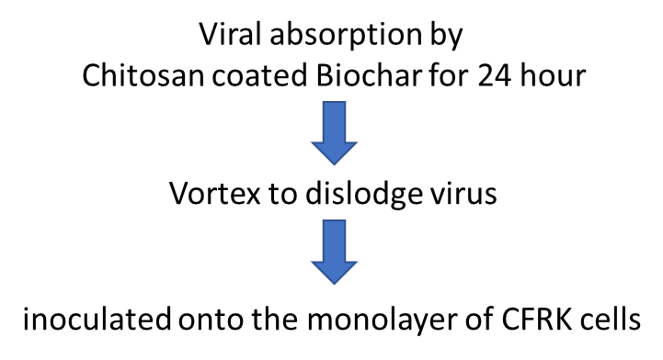
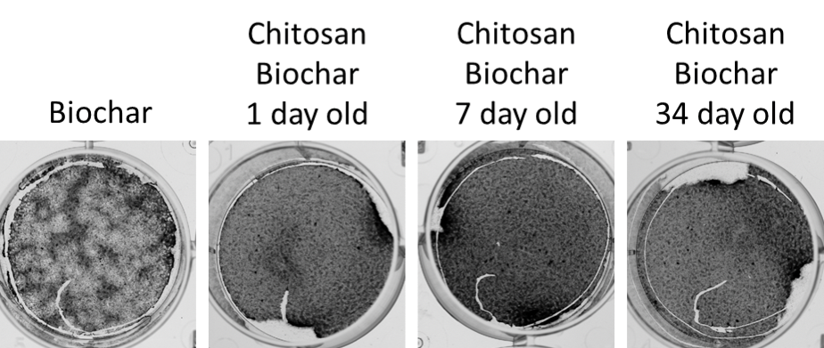
Coronavirus test results, persistence of coating effectiveness to 34 days
Log Kill 0.25 5.57 5.27 5.31
99.999+% 99.999+% 99.999+% 99.999+%
October 2020

Slide 4
Biochar
Biochar test method for Coronavirus testing
Biochar is a fine-grained charcoal high in organic carbon
Produced from pyrolysis of plant and wastes
Pyrolysis is transformation of a compound into smaller and simpler compound under the temperature ranging 400 to 800 oC in the absence or little oxygen
Generates high porosity materials

Slide 5
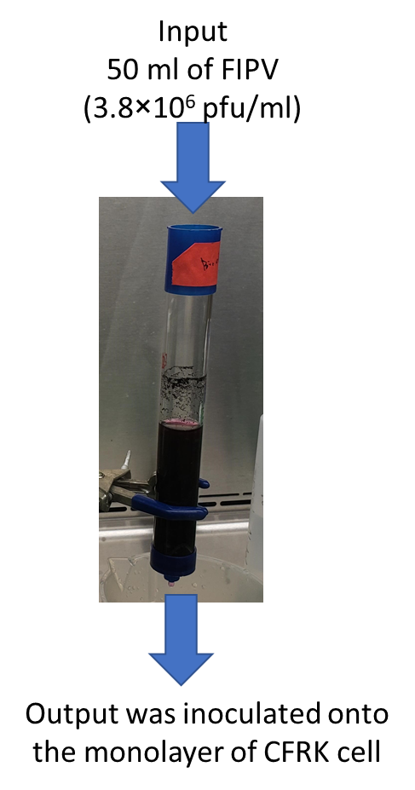
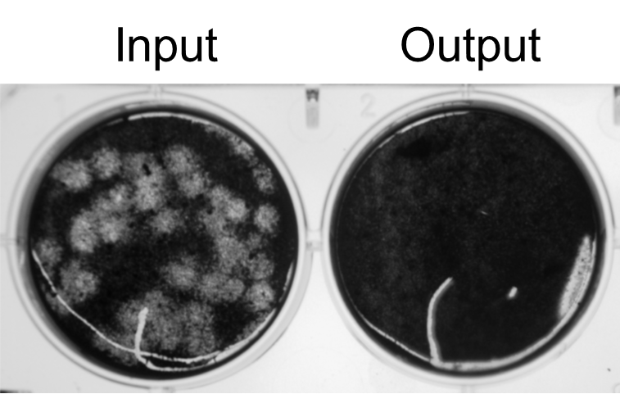
Biochar absorb FIPV to sterilize

Slide 6
BacShield RTU highly effective against hospital acquired pathogens
MRSA
S. intermedius
VRE faecalis
VRE faecium
Carbapenem resistant
E. coli
Carbapenem resistant
K. pneumoniae
Pseudomonas
aeruginosa
0.1%
0.3%
0.5 %
1.0 %
VC

Slide 7
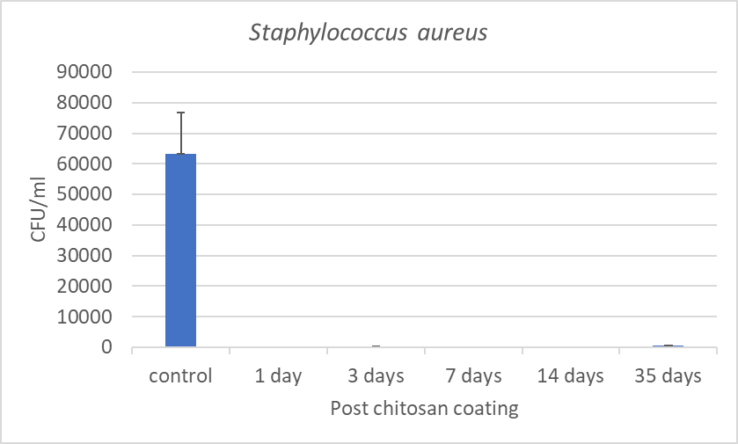
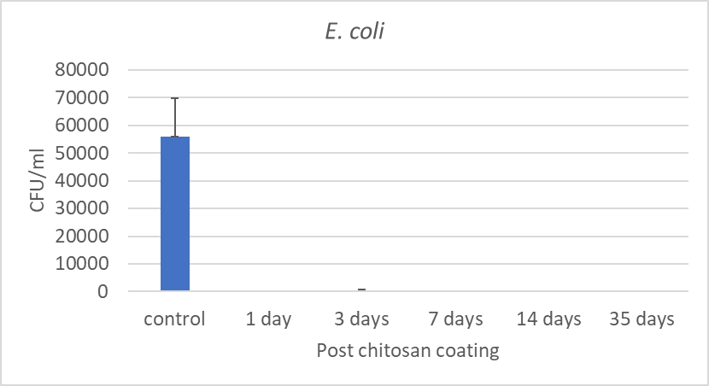
Chitosan coated surface showed long-lasting antimicrobial effect
Coat cell culture wells with chitosan solution
Air dry to form thin film
Inoculate bacteria
Determine viable bacterial count

Slide 8
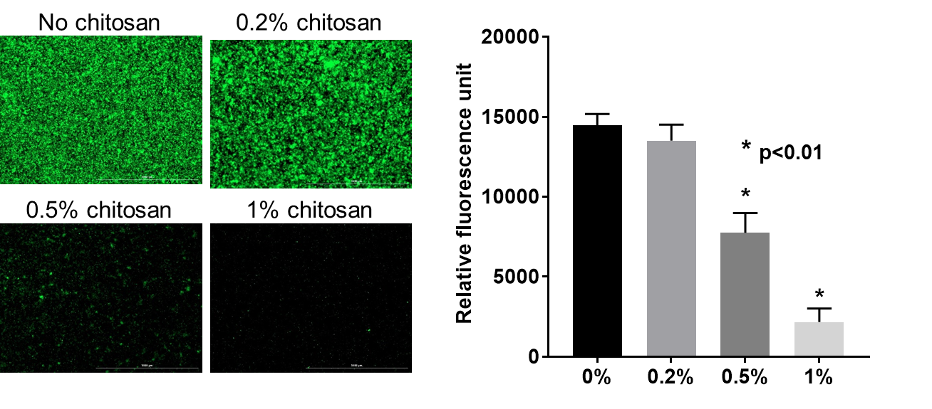
Coat cell culture wells with chitosan solution (0, 0.2, 0.5, 1% w/v)
Overnight incubation at 4 ºC
Inoculate GFP positive S. aureus in BHI
Remove chitosan solution
Gently wash and determine fluorescent intensity
Incubation at 37 ºC for 3 days

Slide 9
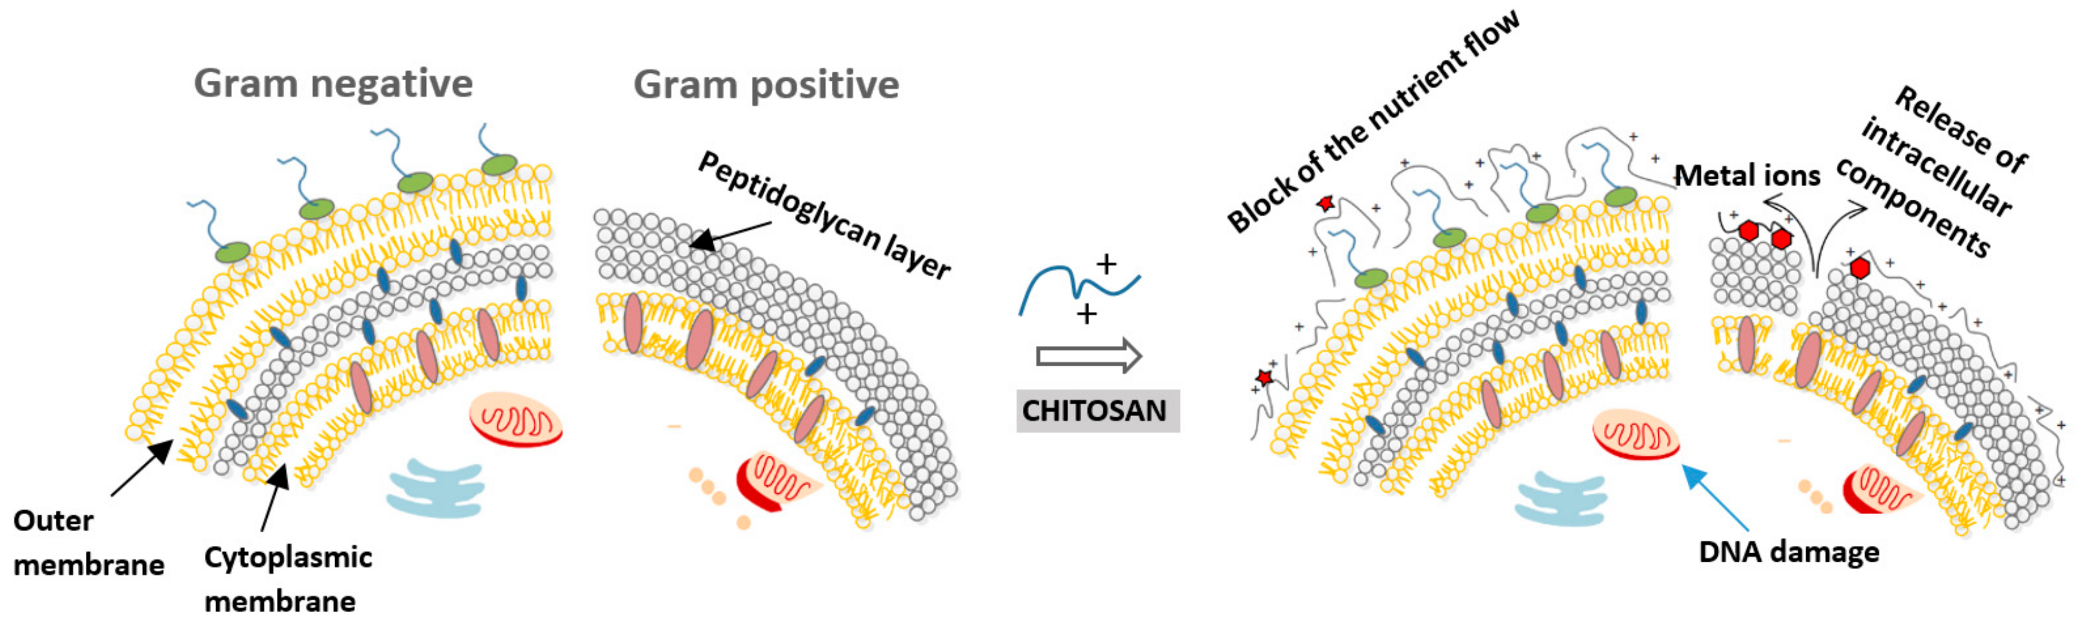
https://doi.org/10.3390/molecules24101960
Antimicrobial effect of chitosan

Slide 10
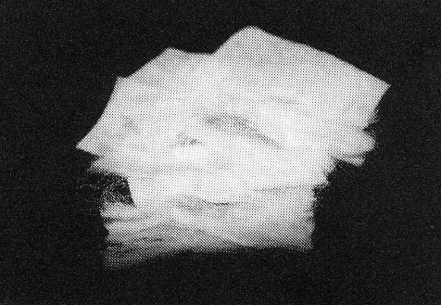
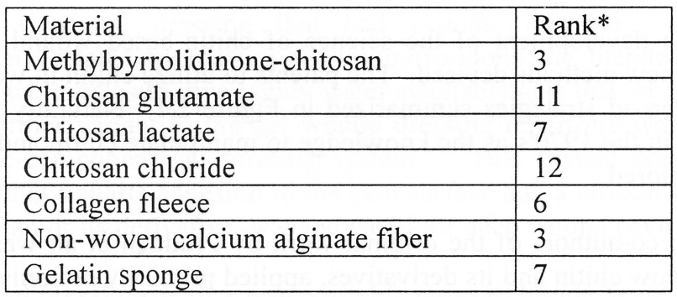
Biomedical Applications
Wound Dressing
Wound dressings are used to protect wounded skin from contamination and infection
Chitin-based wound dressings
- Increase dermal regeneration
- Accelerate wound healing
- Prevent bacteria infiltration
- Avoid water loss
Chitin surgical threads - strong, flexible, decompose after the heals
[1]
Chitosan wound dressings
Anticoagulation
Anticoagulation is essential for open-heart surgery and kidney dialysis
Preventing blood from clotting during the surgery
Sulfated chitin derivatives have good anticoagulant activity
[2]
Cell culture compatibility ranking of wound dressing materials
[1] Kohr E. Chitin: fulfilling a biomaterials promise. Elsevier Science, 2001
[2] Khor E. Lee Y.L. Implantable applications of chitin and chtosan. Biomaterials 24 (2003) 2339

Slide 11
Biomedical Applications
Tissue Engineering
Tissue engineering research is based on the seeding of cells onto porous biodegradable matrix
Chitosan can be prepared in porous forms permitting cell growth into complete tissue
Orthopedic Applications
Porous character of chitosan scaffold
[1]
Bone is a composite of soft collagen and hard hydroxyapatite (HA)
Chitin-based materials are suitable candidate for collagen replacement (chitin-HA composite)
Mechanically flexible, enhanced bone formation
Temporary artificial ligaments for the knee joint
50μm
[1] Sundararajan V. et al. Porous chitosan scaffolds for tissue engineering Biomaterials 20 (1999) 1133
Ratner B.D. Biomaterials Science 2nd edition. Elsevier Science, 2004, chapter 7

Slide 12
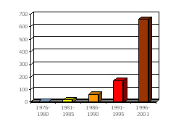
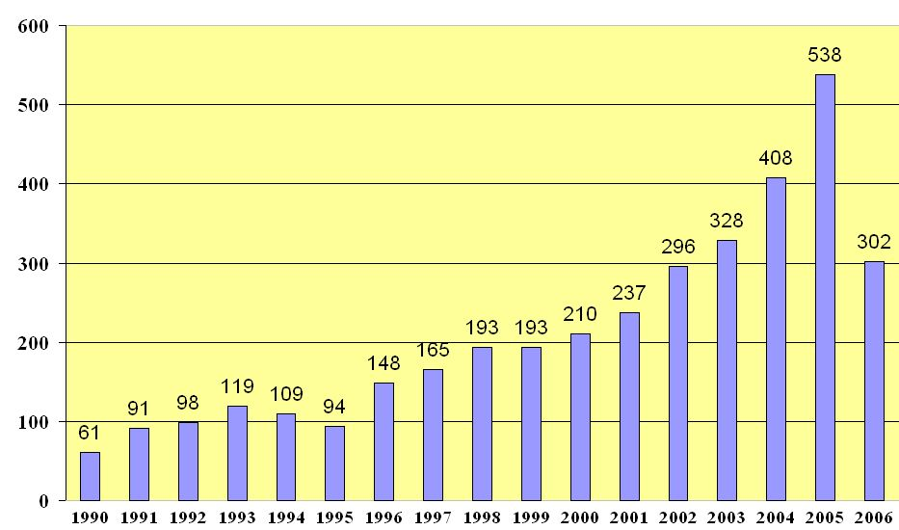
Number of US patents
Survey of the scientific literature
International conferences
International Conference on Chitin and Chitosan (ICCC)
International Conference of the European Chitin Society (EUCHIS)
International Conference “New achievements in study of chitin and chitosan”
Asia-Pacific Chitin Chitosan Symposium (APCCS)
The number of chitin scientific reports since 1990 as obtained from ScienceDirect®
The number of reports of 2006 is through April, 15th
Source: www.sciencedirect.com/
Global interest on chitosan

Slide 13
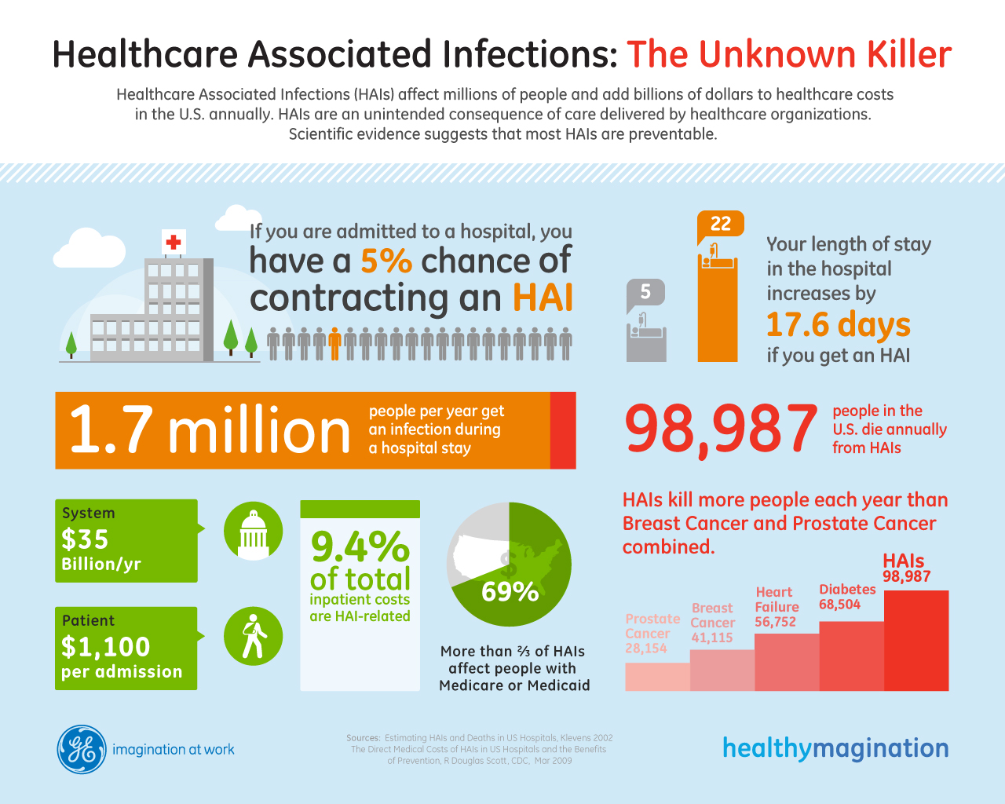

Slide 14
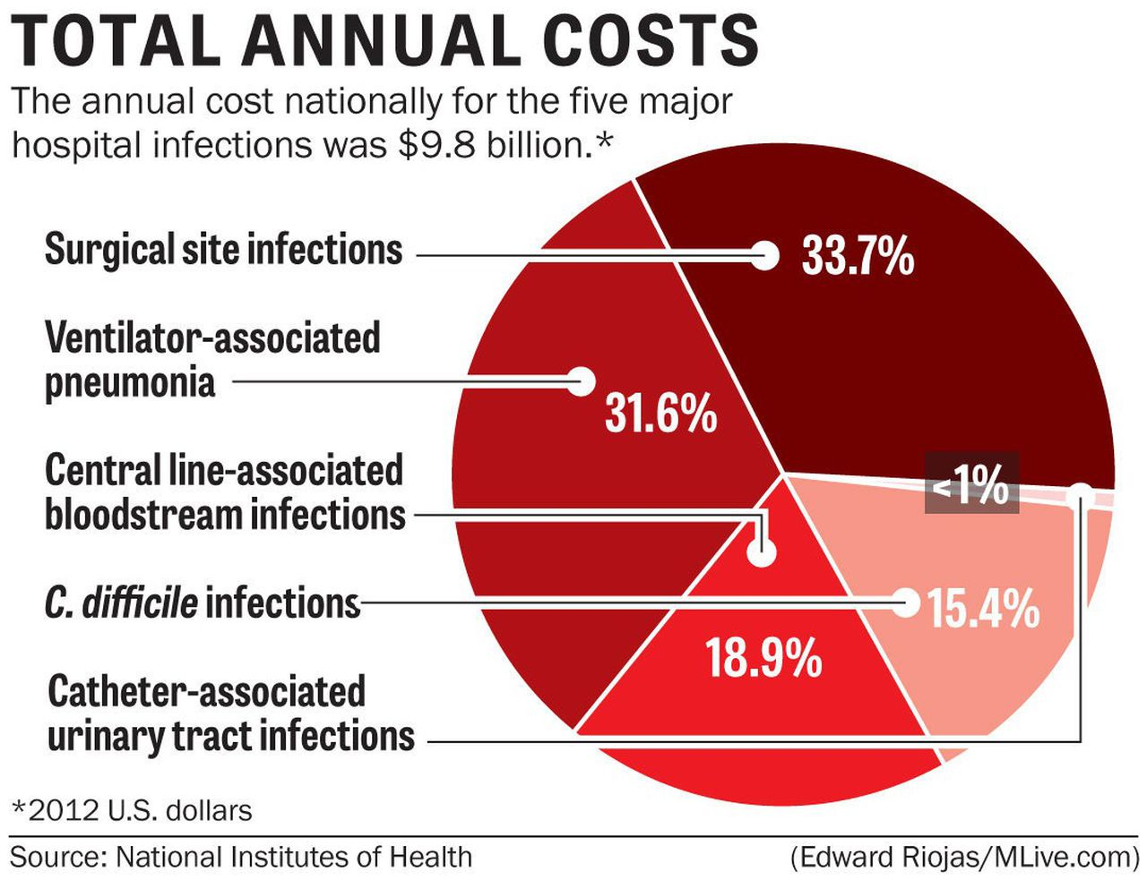

Slide 15
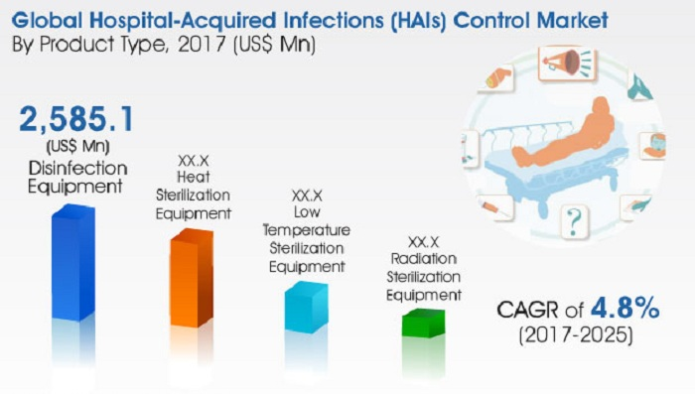

Slide 16
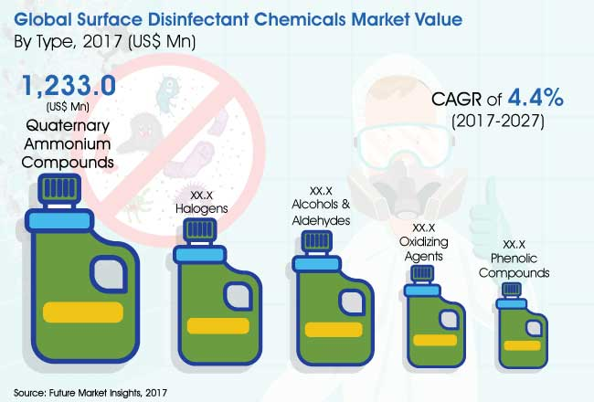

Slide 17
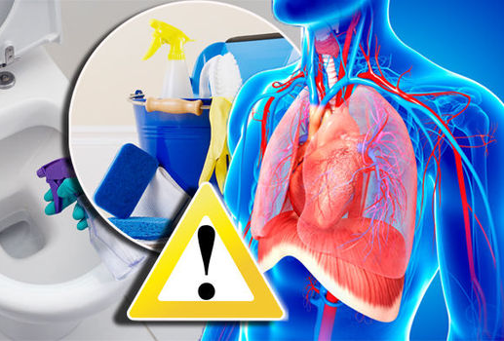

Regular Chemical Disinfectant Exposure May Increase Risk Of COPD

Slide 18
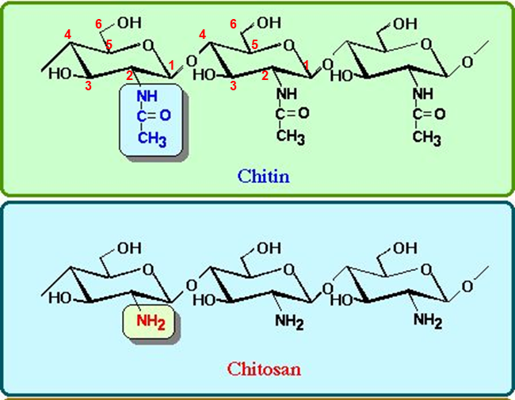
Chitin is a natural polysaccharide
The 2nd abundant organic source on earth
Structure like cellulose with hydroxyl group replaced by acetamido group
N-acetyl-glucosamine units in β-(1→4) linkage
Chitosan is the N-deacetylated derivative of chitin
N-glucosamine units in β-(1→4) linkage
N-deacetylation of chitin into chitosan is achieved by treating with 50% NaOH
What is chitosan?

Slide 19
Unique characteristics of chitin and chitosan:
Biocompatible
Biodegradable
100% Non-toxic
Remarkable affinity to proteins
Ability to be functionalized
Renewable
Abundant
Chitosan: a promising material
Muzzarelli R. et al, Chitin in Nature and Technology. Plenum Press NY, 1985

Slide 20

BacShield RTU from Cleaner Solution International, LLC
Top Security buildings have security guards and a fence. A disinfectant is the security guard who patrols every few hours. BacShield RTU is the fence that surrounds the compound 24/7. Together, they are the premier defense system to stop the spread of disease.
To Order Call (803) 262-0677

